Slide 1


Sap ABAP on Hana &
s/4hana trainings
Anubhav Oberoy

Slide 2

INTRODUCTION

Slide 3
Agenda – Day 3
Performance Guideline for ABAP CODE
Describing SQLM (SQL Monitor)
Understanding Code inspector variants
Describing Data Migration Point
Static check with SQL performance
SQL performance Tuning work list monitor ( SWLT )
---Break---
OIA Scenario ( Open Item Analysis )
Articulate Requirement for OIA
Execute OIA on ABAP
SQL Console
Introduction to HANA Database User
Data Modeling
Attribute View
Analytics View
Calculation View
Graphical Calculation Views
Scripted Calculation Views
Classification of Join

Slide 4
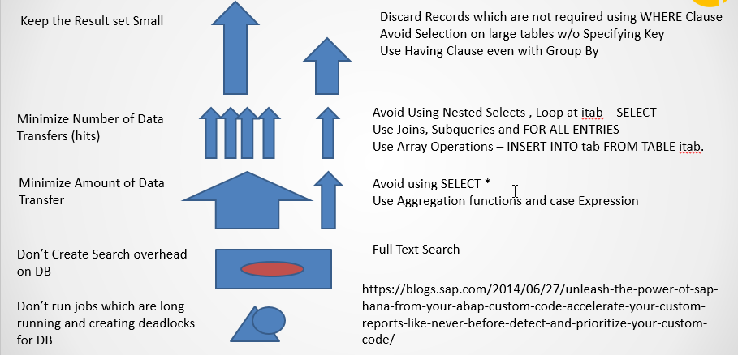
Performance Guild line for ABAP Code

Slide 5
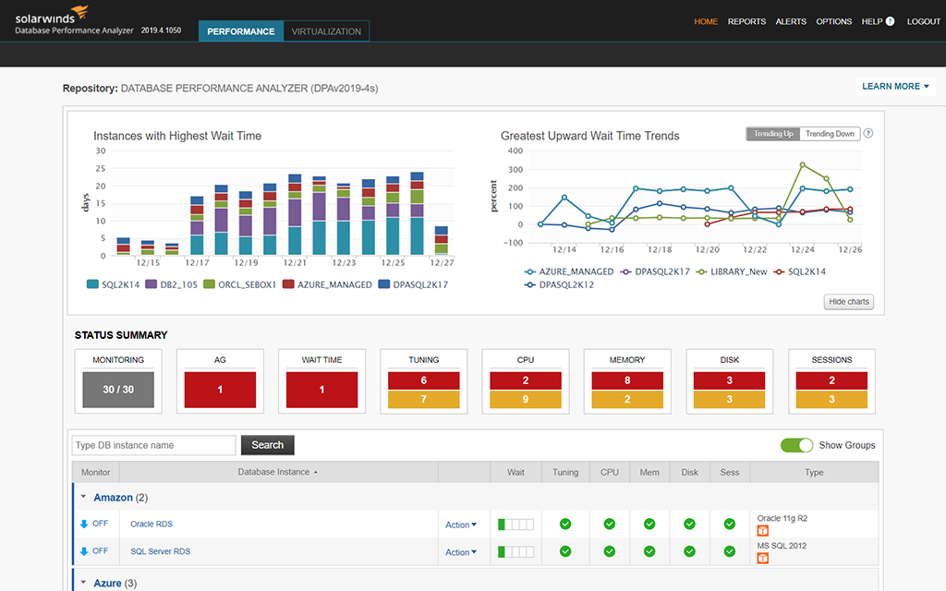
SQLM_SQL Monitor
This is a tool developed by SAP and available since NW 7.4 in all systems to monitor SQL statement performance in terms of DB Time, avg. time taken per request, DB Records, Iterations, over all consumption.
This is the recommended tool to be used in ABAP On HANA systems (production) w/o affecting performance.
Most expensive request entry point (Transaction, BG Job, Program, Report) In terms of DB Time
In these entry points itself, which SQL Query Dominates the SQL Profile
Most Expensive or Used Query in Whole System
When should we start and stop trace, timeframe?
Whenever the system is MOST Busy usually its during month end, Q end. Usually 2 takt’s – 4 weeks

Slide 6
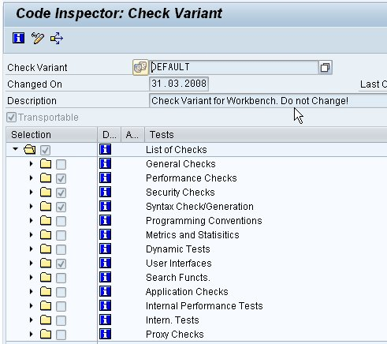
Code Inspector Variant
Setting Code Inspector Custom Variant as Default Code Inspector variant. ... In general whenever we develop any object or make any changes in any object, we go to Transaction SCII and run the code inspector for Z created Variant instead of directly checking it from Object menu Class/Program/Function module etc.

Slide 7
SQL Performance Tuning Worklist
The SQL Performance Tuning Worklist (transaction SWLT) enables you to find ABAP SQL code that has potential for performance improvement. This tool combines information from static ABAP code scans that normally run in a test or quality system with runtime data from the SQL Monitor that typically originates from the productive system. Based on data records collected by the SQL Monitor, the SQL Performance Tuning Worklist automatically creates a worklist and allows you to rank the findings according to specific performance issues and their business relevance.
Findings from
SCI/ATC
Which are all
violation of
guidelines
SQLM tool for most
used and domination
SQL statements
Priorities
Notes:
The sole purpose of an R/3 system is to provide a suite of tightly integrated, large-scale business applications. R/3 comes prepackaged with the core business applications needed by most large corporations. These applications coexist in one homogenous environment. They are designed from the ground up to run using a single database and one (very large) set of tables.
Presentation: It is usually installed on a user's workstation. When started, the presentation server displays the R/3 menus within a window. This window is commonly known as the SAPGUI, or the user interface (or simply, the interface).
Basis : Basis is like an operating system for R/3. It sits between the ABAP/4 code and the computer's operating system. SAP likes to call it middleware because it sits in the middle, between ABAP/4 and the operating system. ABAP/4 cannot run directly on an operating system. It requires a set of programs (collectively called Basis) to load, interpret, and buffer its input and output. Basis provides the runtime environment for ABAP/4 programs.
Database: The database server is a set of executables that accept database requests from the application server. These requests are passed on to the RDBMS (Relation Database Management System). The RDBMS sends the data back to the database server, which then passes the information back to the application server. The application server in turn passes that information to your ABAP/4 program.

Slide 8
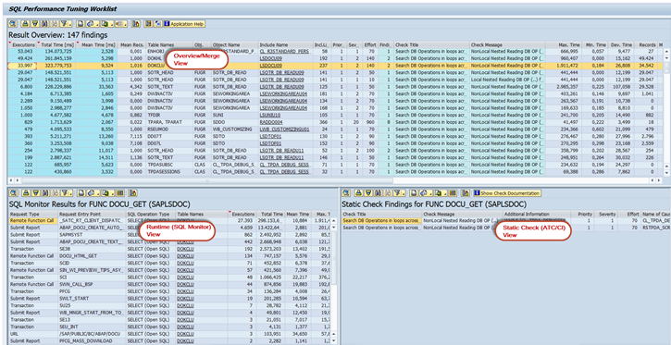
SQL Worklist Tool ( SWLT )

Slide 9

Break

Slide 10

OIA Scenario - Open Item Analysis
Mr. Jems (Account Receivable Accountant)
Mr. Jems is a 63 year old men, working in our Toronto office since last 30 years of service. He lives in downtown near the lake in his own 680 Sq yard home. He is a proud father of 2 girls which are studying. And drives Audi A6.
He is a seasonal Skiing player.
Cash has a very important role in a company for running business. It is in the best interest of the company to collect the pending dues from their customers as soon as possible. By putting this Cash back into the system, the company can execute is ambitions and expansion plans faster. So Mr. Jems is here working as an account receivable accountant, his job is to manage customer accounts and remind them for their unpaid bills when the bill amount OR the average days for unpaid invoices are passed. Classify these customers based on their ability to pay pending bills.

Slide 11
Articulate Requirement for OIA
Create a DB table which stores the customizing – Threshold – Days, Amount
How long on average basis the invoices are outstanding – UNPAID
Invoices which are unpaid – SNWD_SO_INV_HEAD Payment_Status = ‘’
Calculate the average open days since when they are unpaid – Sum / Count
Business partners and company names for those invoice SNWD_BPA
Check the total gross amount of invoices which is open in “common currency”
Invoice header to identify the unpaid invoices – SNWD_SO_INV_HEAD
For each invoice read the line items from SNWD_SO_INV_ITEM and convert to common currency.
Currency conversion based on customizing will be done for items
A total open amount will be calculated in common currency (gross_amount)
Business partner information to find which co. SNWD_BPA
Classify the customers which are at high risk
5. Dunning – Reminders / calls for making payment
COLLECT statement in ABAP.??

Slide 12
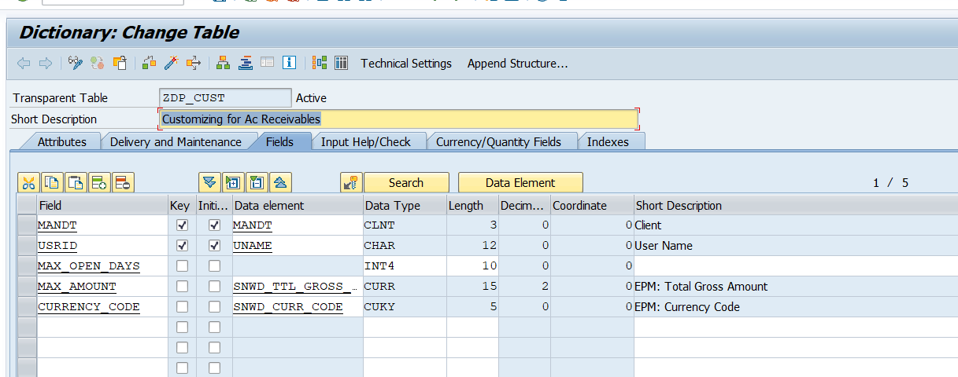
Custom Table

Slide 13
Modeling
Challenges with ABAP Coding / SQL Queries
Not everyone is so experienced to write optimized SQL query
Sometimes, we do incorrect nesting unknowingly which cause a recurring DB calls
Many colleagues are not from ABAP background with coding skills
Let someone else optimize the queries for us for DB
Easy way to write complex requirements any one can develop w/o much experience
Modeling is a field of Database engineering which allows developers/consultants to build a graphical model w/o getting too much into technical stuff. The system will then compute the model and generate DB objects automatically which are also optimized to get best performance.
Models in SAP HANA
Attribute View
Analytic View
Calculation View
Deprecated – There is no support for bug fix, and there are no new features.
Obsolete – You cant even do it.

Slide 14
Why 3?
Models in SAP HANA
Attribute View
Analytic View
Calculation View
Processed inside JOIN engine
Is to read master data and joins must faster than any other views
We must mark key field while developing attribute views
Add calculations also
5 types of Joins
Processed inside OLAP/Analytic engine
Is to read combination of transaction and master data
Good performing Aggregations like SUM, MIN, MAX, COUNT, AVG
Perform Currency conversion
Run Analytics on top
Most powerful view type
Multi purpose, read any source table, other view
Processed in calculation engine
Have lots of build in functions
Graphical or Scripted
Graphical
Scripted
https://archive.sap.com/documents/docs/DOC-73509#:~:text=For%20all%20other%20cases%20Analytical,foundation%20node%20allows%20views%2Ftables.

Slide 15
Classification of Joins in HANA
Inner join- Intersection of two tables, fetch exact matching column data from joined tables.
Left outer Join – will fetch intersection + extra data from left table which has no matching records in right table
Right Outer Join – will fetch intersection + extra data from right table which has no matching records on left side
Temporal Join – This join enables a join with TIME dimension, in HANA there are M* tables which represent time dimension.
Spatial Join – Join geo stationary coordinate to calculate distances, locations, area, ..
Star Join – When we have more than one analytic views to be joined, we use star join.
Text Join – Text always used to join text tables, which has language specific description. System automatically pass the current login language to the join and text table. We need to mark language column while doing this join.
A
B
A
B
A
B

Slide 16
Classification of Joins in HANA
8. Referential Join – is a smart INNER JOIN. The join will be executed as inner join when columns from both tables are
selected in the query. But when the query has selected ONLY columns from one of the table alone, the join will be pruned (abandoned/ignored)
BookingID | Date
10001 | 01.03.2021
10002 | 02.04.2021
10003 | 03.04.2021
FlightDate | Airline
01.03.2021 | FedEX
02.04.2021 | DHL
04.04.2021 | FFFL
HANA View – AT_FF
Inner Join – Join is always applied Referential Join
Q1 - SELECT bookingId, Airline From AT_FF
FedEx
DHL
Q2 – Select BookingID from AT_FF;
10001
10002
JOIN is BOUND to HAPPED
Q1 - SELECT bookingId, Airline From AT_FF
FedEx
DHL
Q2 – Select BookingID from AT_FF;
10001
10002
10003

Slide 17
Feedback
AnubhavTrainings.com :
https://www.anubhavtrainings.com

Slide 18
End of Day 3

Slide 19

Questions

Slide 20

Anubhav Oberoy

